Slide 1
Positioning & Centering
Week 5

Slide 2
Positioning

Slide 3
Recall the layouts we learned
Block Formatting Context
Inline Formatting Context
Every child has to participate in the layout… But what if…

Slide 4
What if… you want something knocked out of the normal flow?

Slide 5
Cue: Position
We use CSS positioning to make something either or not following the normal flow

Slide 6
Yet, what's a "normal flow"?

Slide 7
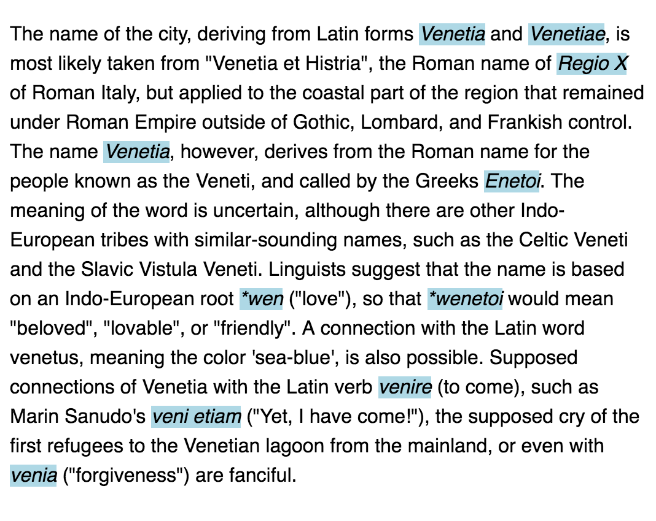
An example of normal flow
em {
background-color: lightblue;
}

Slide 8
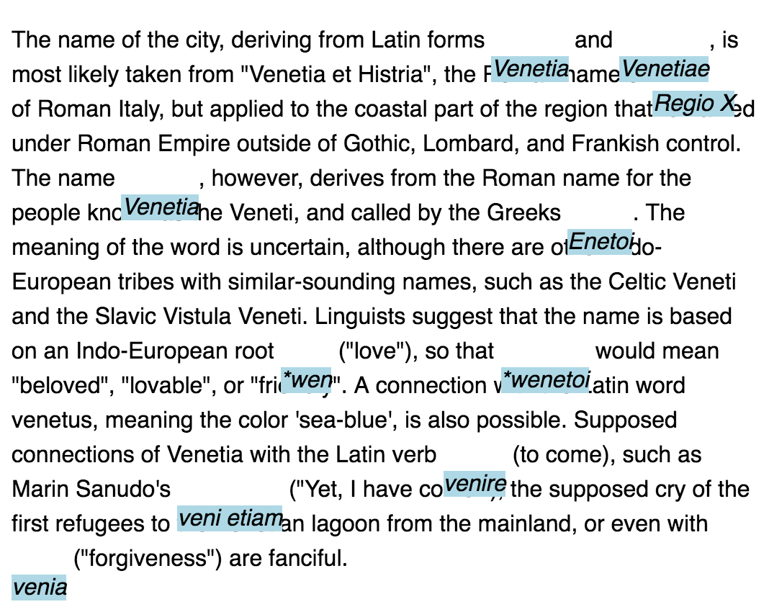
Say em elements are in the normal flow, but offset
em {
background-color: lightblue;
/* New lines added below */
position: relative;
top: 20px;
}

Slide 9
A few ways you can position an element
static (default) Position the element according to the normal flow.
relative Position the element according to the normal flow, and then offset relative to itself. The offset doesn't affect the surrounding elements.
absolute The element is pulled out of the normal flow, and positioned relative to its closest positioned ancestor.
fixed The element is pulled out of the normal flow, and positioned relative to the window/viewport.

Slide 10
A few ways you can position an element
static (default) Position the element according to the normal flow.
relative Position the element according to the normal flow, and then offset relative to itself. The offset doesn't affect the surrounding elements.
absolute The element is pulled out of the normal flow, and positioned relative to its closest positioned ancestor.
fixed The element is pulled out of the normal flow, and positioned relative to the window/viewport.

Slide 11
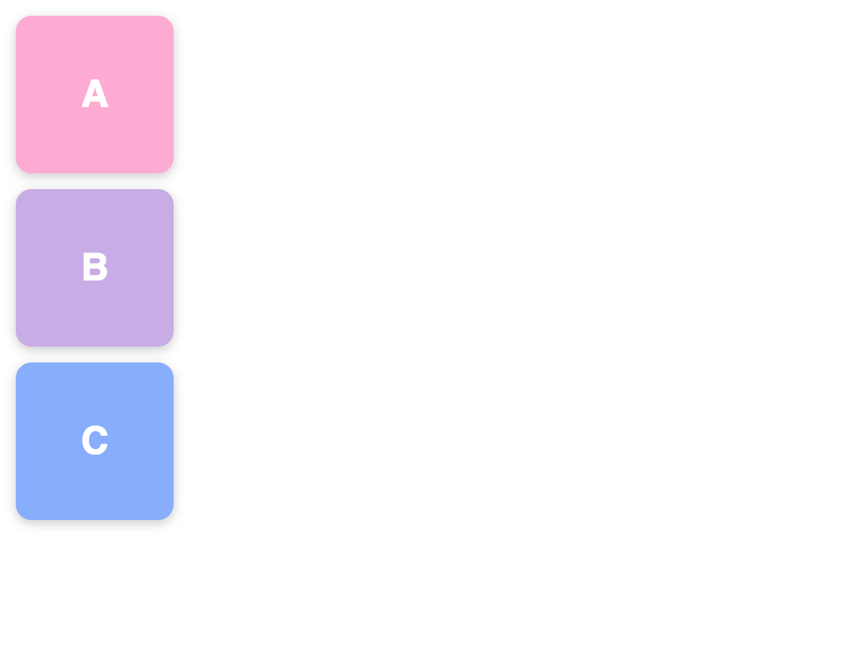
static
.a {
position: static;
}
.b {
position: static;
}
.c {
position: static;
}

Slide 12
A few ways you can position an element
static (default) Position the element according to the normal flow.
relative Position the element according to the normal flow, and then offset relative to itself. The offset doesn't affect the surrounding elements.
absolute The element is pulled out of the normal flow, and positioned relative to its closest positioned ancestor.
fixed The element is pulled out of the normal flow, and positioned relative to the window/viewport.

Slide 13
static
.a {
position: static;
}
.b {
position: static;
}
.c {
position: static;
}

Slide 14
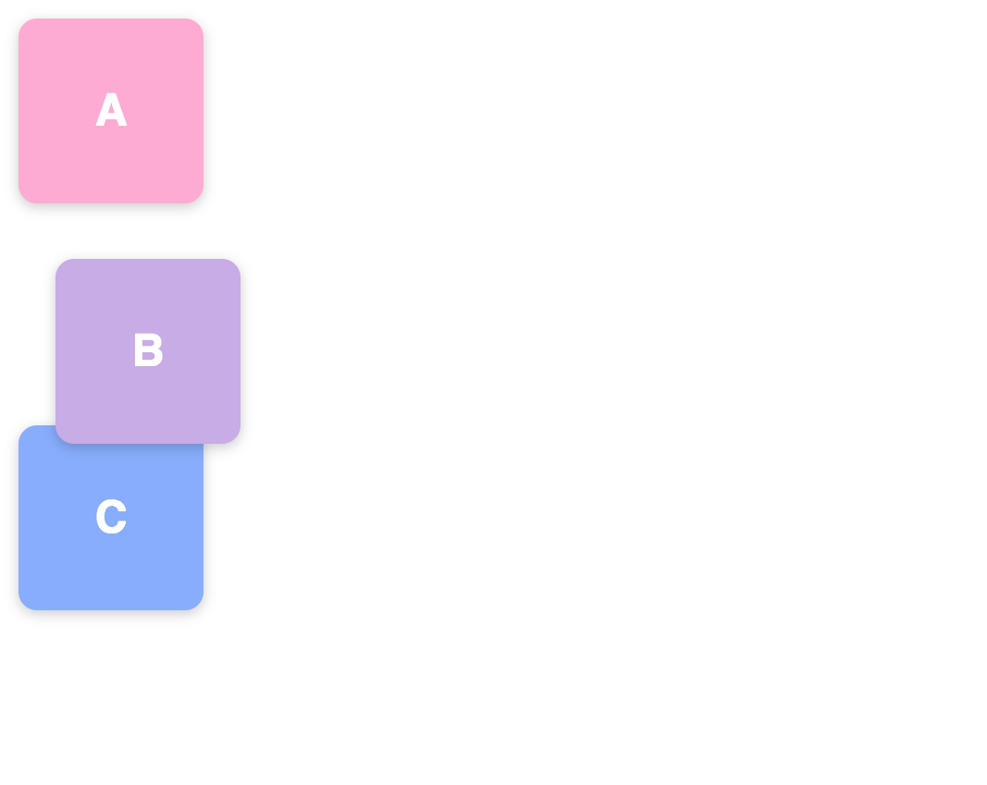
relative
.a {
position: static;
}
.b {
position: relative;
top: 20px;
left: 20px;
}
.c {
position: static;
}

Slide 15
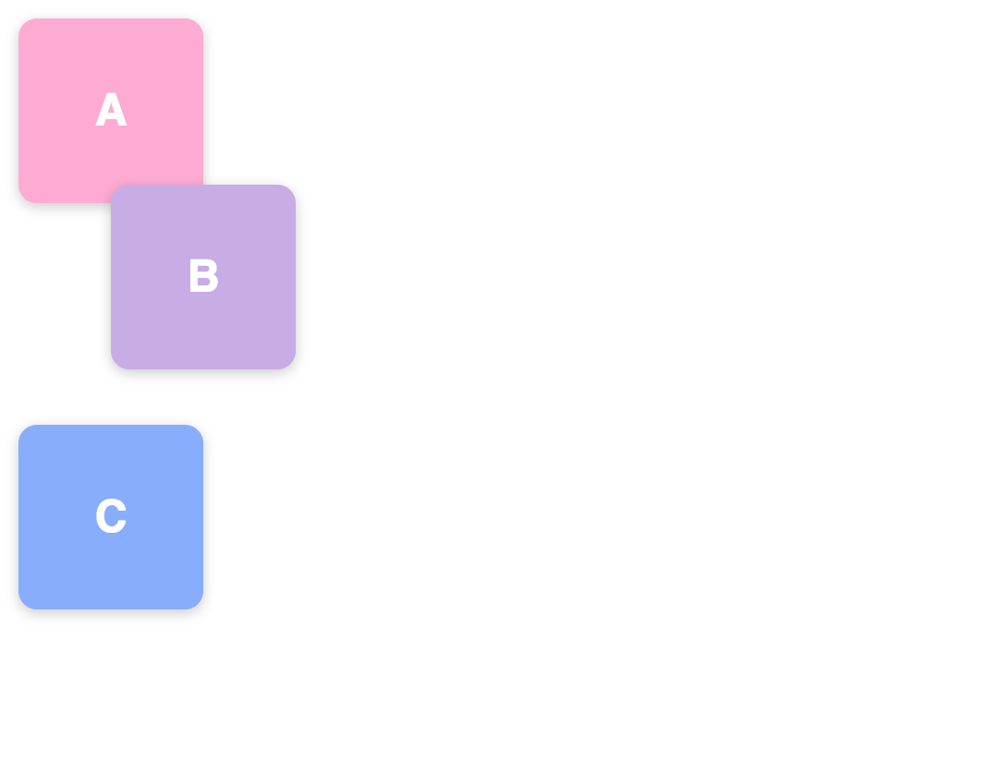
relative
.a {
position: static;
}
.b {
position: relative;
left: 50px;
bottom: 20px;
}
.c {
position: static;
}

Slide 16
A few ways you can position an element
static (default) Position the element according to the normal flow.
relative Position the element according to the normal flow, and then offset relative to itself. The offset doesn't affect the surrounding elements.
absolute The element is pulled out of the normal flow, and positioned relative to its closest positioned ancestor.
fixed The element is pulled out of the normal flow, and positioned relative to the window/viewport.

Slide 17
static
.a {
position: static;
}
.b {
position: static;
}
.c {
position: static;
}

Slide 18
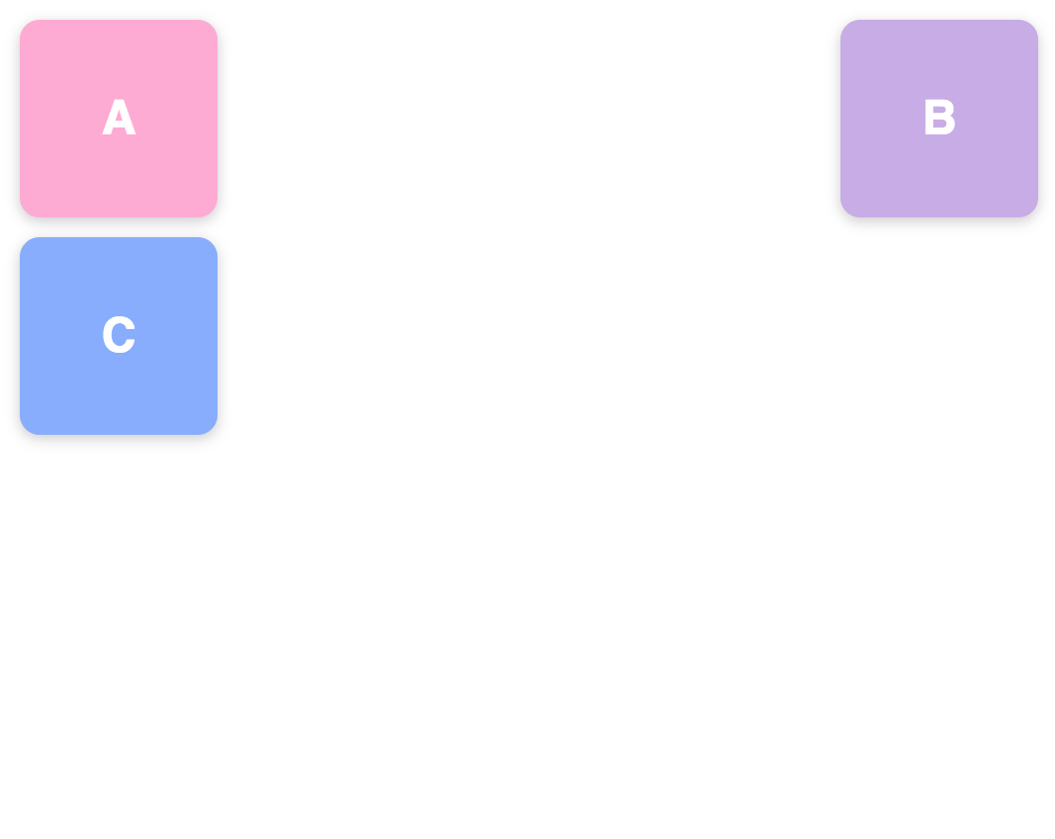
absolute
.a {
position: static;
}
.b {
position: absolute;
top: 0; /* Top margin edge */
right: 0; /* Right margin edge */
}
.c {
position: static;
}

Slide 19
A few ways you can position an element
static (default) Position the element according to the normal flow.
relative Position the element according to the normal flow, and then offset relative to itself. The offset doesn't affect the surrounding elements.
absolute The element is pulled out of the normal flow, and positioned relative to its closest positioned ancestor.
fixed The element is pulled out of the normal flow, and positioned relative to the window/viewport.

Slide 20
fixed
.a {
position: static;
}
.b {
position: fixed;
top: 0;
right: 0;
}
.c {
position: static;
}

Slide 21
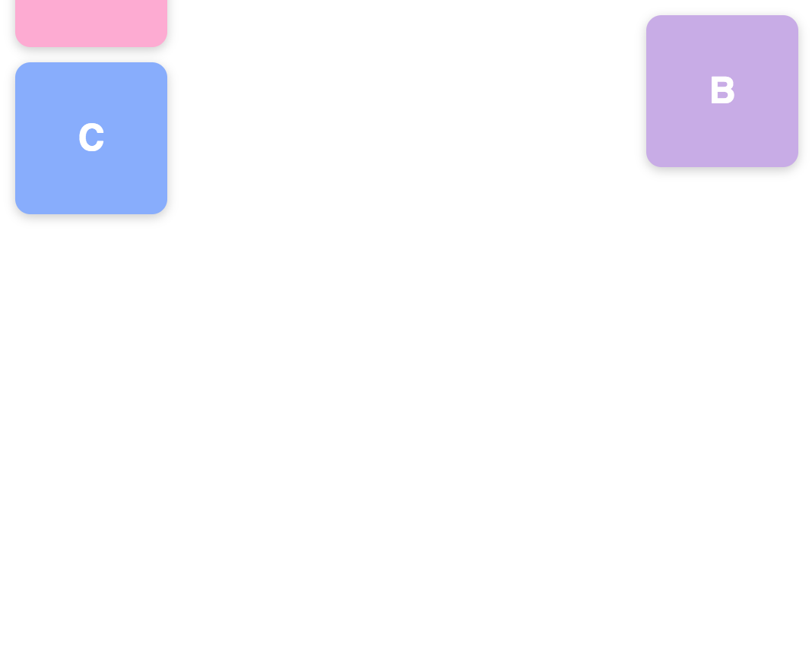
fixed
.a {
position: static;
}
.b {
position: fixed;
top: 0;
right: 0;
}
.c {
position: static;
}

Slide 22
A few ways you can position an element
static (default) Position the element according to the normal flow.
relative Position the element according to the normal flow, and then offset relative to itself. The offset doesn't affect the surrounding elements.
absolute The element is pulled out of the normal flow, and positioned relative to its closest positioned ancestor (padding-box).
fixed The element is pulled out of the normal flow, and positioned relative to the window/viewport.
Notes:
Mention positioning should be used sparingly

Slide 23
Centering

Slide 24
To center things in a block/inline layout…

Slide 25
To center things in a block/inline layout…
Horizontally center block elements
Horizontally center inline elements
Vertically center block elements
Vertically center inline elements
Follow along here: https://codepen.io/sethlu/pen/JzRyKy

Slide 26
To center things in a block/inline layout…
Horizontally center block elements
Horizontally center inline elements
Vertically center block elements
Vertically center inline elements

Slide 27
Horizontally center block elements
.potato {
}

Slide 28
Horizontally center block elements
.potato {
margin-right: auto;
margin-left: auto;
}

Slide 29
Horizontally center block elements
.potato {
margin: 0 auto;
}
Notes:
Shorthand!

Slide 30
To center things in a block/inline layout…
Horizontally center block elements
Horizontally center inline elements
Vertically center block elements
Vertically center inline elements

Slide 31
Horizontally center inline elements
.small-potato {
}

Slide 32
Horizontally center inline elements
.farm {
text-align: center;
}
.small-potato {
}

Slide 34
To center things in a block/inline layout…
Horizontally center block elements
Horizontally center inline elements
Vertically center block elements
Vertically center inline elements

Slide 35
Vertically center block elements w/ absolute position
#big-potato {
width: 100px;
height: 50px;
}

Slide 36
Vertically center block elements w/ absolute position
#big-potato {
width: 100px;
height: 50px;
position: absolute;
top: 50%;
}

Slide 37
Vertically center block elements w/ absolute position
#big-potato {
width: 100px;
height: 50px;
position: absolute;
top: 50%;
margin-top: -25px;
}

Slide 38
Vertically center block elements w/ absolute position
#big-potato {
width: 100px;
height: 50px;
position: absolute;
top: 50%;
transform: translateY(-50%);
}
What's the 50% doing in the transform?

Slide 39
We can center-center things too

Slide 40
Vertically center block elements w/ absolute position
#big-potato {
width: 100px;
height: 50px;
position: absolute;
top: 50%;
margin-top: -25px;
}

Slide 41
Center center block elements
#big-potato {
width: 100px;
height: 50px;
position: absolute;
top: 50%;
left: 50%;
margin-top: -25px;
margin-left: -50px;
}

Slide 42
Center center block elements
#big-potato {
width: 100px;
height: 50px;
position: absolute;
top: 50%;
left: 50%;
transform: translate(-50%, -50%);
}

Slide 43
To center things in a block/inline layout…
Horizontally center block elements
Horizontally center inline elements
Vertically center block elements
Vertically center inline elements

Slide 44
Like this… Well it's not that easy to do

Slide 45
However, you can position inline elements within their line box!
Let's start with a questionably motivational question

Slide 46
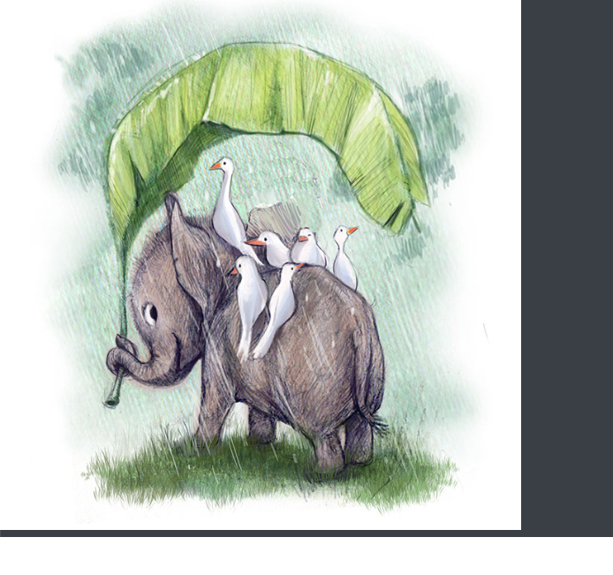
"Sometimes I find some blank space below my image?!"
Example: https://codepen.io/sethlu/pen/pYErMe

Slide 47
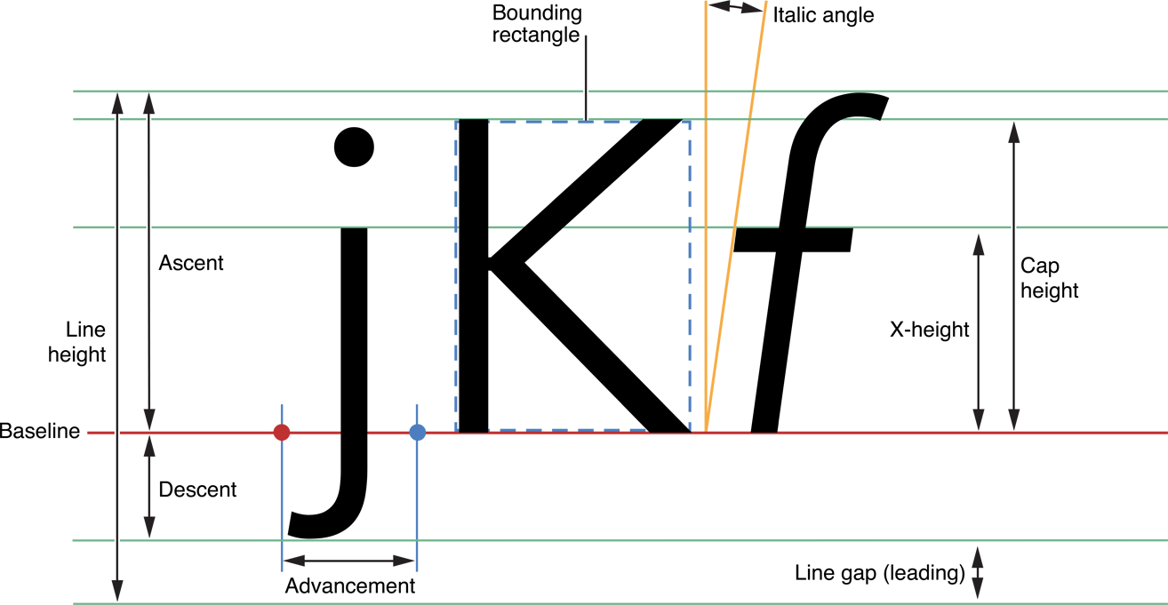
Some font metrics (this is a lot… we don't expect you to know all of it)
Notes:
Diagram credit: https://developer.apple.com/library/archive/documentation/StringsTextFonts/Conceptual/TextAndWebiPhoneOS/CustomTextProcessing/CustomTextProcessing.html

Slide 48
Top (of line height)
Baseline
Bottom (of line height)
By default, inline elements are placed on the baseline
Notes:
Diagram credit: https://developer.apple.com/library/archive/documentation/StringsTextFonts/Conceptual/TextAndWebiPhoneOS/CustomTextProcessing/CustomTextProcessing.html

Slide 49
If there's space between the baseline and the bottom of the line height, then there won't be blank space
If we don't fix the blank space, it will grow with font size of with line height
Bottom (of line height)
Baseline
Bottom (of line height)

Slide 50
And now we can work around the issue!
Either place the image at the bottom…
Or display the image as a block element (then no need to care about the vertical aligning)

